Slide 1

Unit 7 Careers
Topic Talk

Slide 2
Activity 1: Pair work
Use the diagram to talk about what you need in your future careers.
Skills:
Personal qualities:
If I want to be a / an _____, I think I need to have / be ______.
...
...
Example: I want to be a lawyer. I think I need to have good communication skills.

Slide 3
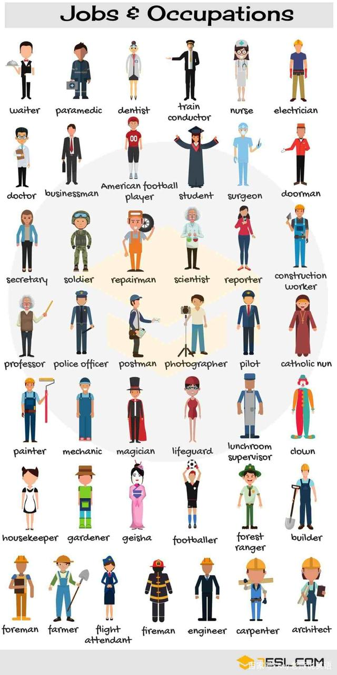
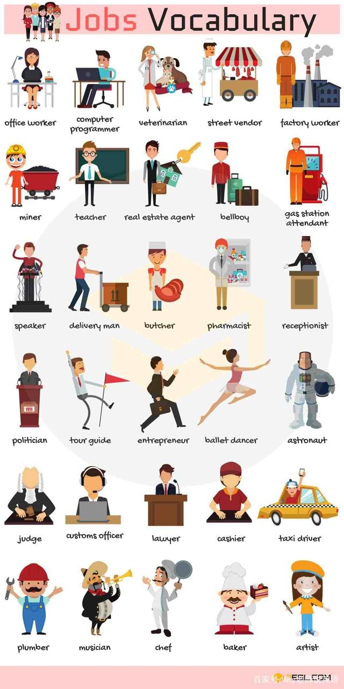
What career do you want to pursue?
I hope I’ll be a / an __________ .

Slide 4
dentist牙科医生 athlete 运动员
engineer 工程师 journalist记者
designer 设计师 physician内科医生
receptionist 接待员 architect 建筑师
editor 编辑 comedian 喜剧演员
photographer 摄影师 psychologist 心理学家
detective 侦探 producer 制作人
consultant 顾问 secretary 秘书
judge 法官 chemist 化学家
librarian图书管理员 composer 作曲家
programmer 程序员 conductor 售票员；指挥
chef主厨 clerk 接待员，办事员

Slide 5
What personal qualities do you need for that career?
I think I need to be _________ .
Personal Qualities:
hard-working
confident
motivated
punctual
准时的
helpful
responsible
flexible
reliable
可靠的
creative
有创造性的
intelligent
聪明的
perseverant
坚持的
devoted/ committed
optimistic
open to new ideas
乐于接受新想法的
imaginative
...

Slide 6
What skills do you need for that career?
I think I need to have ____________ .
Skills:
administration skills
行政执行能力
language skills
语言技能
driving
开车
typing
打字
technical skills
专业技能
management skills
管理技能
communication skills
沟通技能
computer skills
电脑技能
e.g. I hope I’ll be a doctor. I think I need to have professional medical skills and be responsible for my patients.

Slide 7

Activity 2
Read the Text Builder carefully. Then listen to the dialogue and complete it by underlining the words or expressions you hear.
Jobs
teacher, secretary, personal assistant, physician, architect, lawyer, receptionist, dentist, chef, butcher, chemist, manager, sales consultant, librarian, radio operator, hotel clerk, salesman / saleswoman
I hope I’ll be a / an ________.
_______

Slide 8
Workplaces and Reasons
Workplaces: a big company, the marketing department, a school, a research institution, a hospital
Reasons: companies develop under the market economy, children use their imaginations in learning, scientists make inventions to solve real-world problems
I’d like to work in ____________
___________________________. I’m fascinated by how ________
______________________________________________________.
_______________________
_________
______________________________
________
Skills and Personal Qualities
skills: administration, language, technical, management, communication
Qualities: hard-working, confident, reliable, creative, intelligent, open to new ideas
I have excellent _________________ skills. I am _______ and I always get on well with everyone I meet.
____________
______

Slide 9
be responsible for 负责… persuade sb. to do sth. 劝说某人做某事 be fascinated by 对…着迷
be suitable for 适合… get on well with 和…友好相处
CV (curriculum vitae) 简历 bachelor’s degree 学士学位
master’s degree 硕士学位 apart from 除了… 之外
let sb. down 让某人失望 rather than 而不是
apply for the position of sales consultant 申请销售顾问这一职位
It gives me the chance to do both of these things. 它给了我同时做这些事的机会。
It was Maths that I studied at university. 我在大学学的是数学。

Slide 10
1. 我将为国家鞠躬尽瘁，死而后已。
2.知之者不如好之者,好之者不如乐之者。
3. I am writing to apply for the position of sales consultant.
4. I am fascinated by sales work, and I think I am pretty suitable
for this position.
5. Not only does I have excellent communication skills, but also I
always can get on well with everyone I meet.

